Slide 1

DUTIES & RESPONSIBILITIES OF ASSISTANT REGIONAL GRAND MASTERS /LODGE IN-CHARGES
Freemasons’ Hall, New Delhi, 8th April 2023
Training Seminar
ARGMs’ & Lodge Incharges
R.W. Bro. Vishal Bakshi
Chairman, RGM's Council for
Growth and Excellence in Freemasonry,
RGLNI

Slide 2
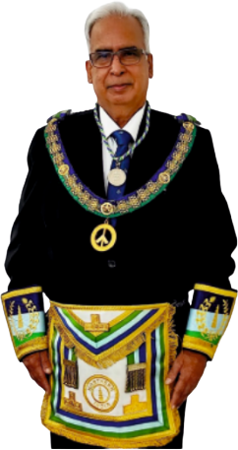
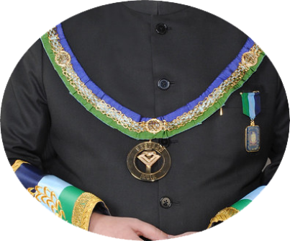
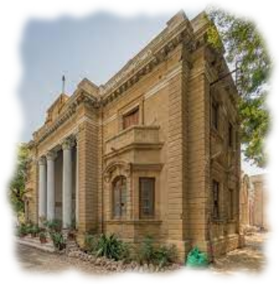
Training Seminar - ARGMs’ & Lodge Incharges
OVERALL ROLE OF ARGMs
ARGM is the representative of the Regional Grand Master. It is a working office and not merely a ceremonial appointment.
ARGM is the most vital link between the Regional Grand Lodge and the Lodges.
RGM
ARGM
LODGE

Slide 3

Key Responsibilities of an ARGM
Growth in membership of Lodges.
Performance of rituals by Lodges in a satisfactory and impressive manner.
Promote Freemasonry by educating Brethren.
Help in spreading information in Society about Freemasonry and our activities.
Ensure Lodges are functioning in regular manner by conforming to all the Rules and Regulations of the Book of Constitutions and Bye-Laws of RGL
Training Seminar - ARGMs’ & Lodge Incharges

Slide 4

Training Seminar - ARGMs’ & Lodge Incharges
Key success factors for an ARGM
Developing cordial relations and comfort level with the WM, Secretary, other Officers and members of the Lodge.
Conducting yourself in a manner that the Lodge looks up to you as guide, mentor and a friend. Avoid being overbearing and dominating in your approach.
Knowing and promoting the importance of harmony in a Lodge.
Keeping in regular touch with the Regional Grand Secretary/RGM.
Thorough knowledge of Book of Constitutions of GLI and Bye-laws of RGL.

Slide 5

ARGM’s CONDUCT INSIDE AND OUTSIDE THE LODGE
Conduct yourself inside the Temple and on the festive board in a dignified manner befitting your stature as ARGM.
ARGM should always be properly dressed.
Give greetings on behalf of RGM and the Region in the Second Rising only.
Festive Board is an extension of the Lodge meeting.
Interact with maximum number of Brethren on the festive board, especially the newly initiated Brethren.
Ensure that Toast of Obligation, Grace and Tyler’s Toast is conducted.
Training Seminar - ARGMs’ & Lodge Incharges

Slide 6

Training Seminar - ARGMs’ & Lodge Incharges
ARGM’s DUTIES VIS-À-VIS THE LODGE
Gather Basic Information about the Lodge:
Familiarise yourself with the history of the Lodge. This can be obtained from RGL/GLI.
Take the list of Members (with details of EAFMs, FCFMs, MMs, PMs).
Initiations conducted by the Lodge in the past.
Names of members who are members of Chapter/Mark/RAM.

Slide 7
ARGM’s DUTIES VIS-À-VIS THE LODGE….contd..
Guidance to Secretary:
Attendance Register and Minutes Book must be there in each Meeting.
Secretary must have Ritual Books, Book of Constitutions, Lodge bye-laws, RGL bye-laws.
GLI, RGLNI Circulars must be read by the Secretary in open Lodge.
Ritual Working:
Guide and motivate Officers and Brethren for good ritual working.
Keep track of the ritual working to be conducted in the next meeting and assist the Officers.
Avoid criticizing Officers/Brethren in case ritual working is not good, instead motivate them.
Training Seminar - ARGMs’ & Lodge Incharges

Slide 8
Training Seminar - ARGMs’ & Lodge Incharges
ARGM’s DUTIES VIS-À-VIS THE LODGE….contd..
Records and Accounts:
Regularly check that all the records are properly maintained.
Ensure that half-yearly returns are filed on time.
Ensure that financial accounts are approved in open Lodge within the time frame stipulated in the Book of Constitutions
Ensure that signatories to the bank account are changed within 15 days of the Installation Meeting
Guidance in matters relating to RGL/GLI:
Guide the Secretary and WM on the procedures for which the Lodge needs RGL and GLI approvals (MM certificate, IM certificate, Amendments to Bye-laws, Dispensations, LTS Jewels)

Slide 9
ARGM’s DUTIES VIS-À-VIS THE LODGE….contd..
Charities:
Ensure that Charity is collected in a proper manner and the amount collected announced by the Secretary in open Lodge.
Encourage and motivate the Lodge to conduct regular charity programmes.
Collect information of the Charity projects done by the Lodge and inform the RGL.
Check the funds available with the Lodge in Charity account and encourage. the Lodge to spend it on Charity rather than accumulating funds.
Training Seminar - ARGMs’ & Lodge Incharges

Slide 10
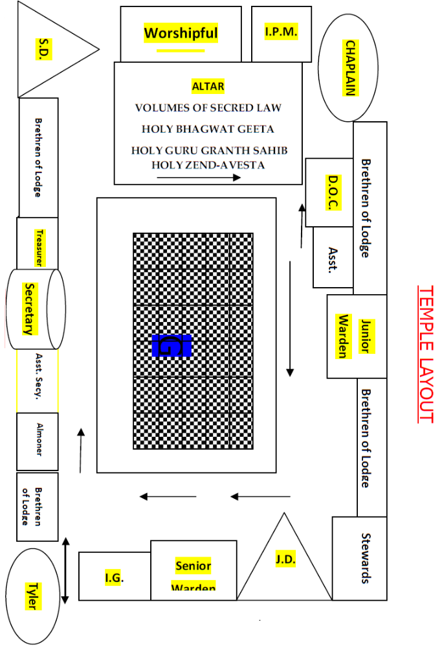
Training Seminar - ARGMs’ & Lodge Incharges
Temple Lay-out, Lodge Furniture & Regalia:
Warrant and Banner of the Lodge to be displayed.
No meeting of a Lodge is regular in the absence of the Warrant.
National Flag should be displayed.
All the VSLs, the Sq. & Compass should be on the Altar.
No gap between WM’s pedestal and Altar.
Rough Ashlar on JW’s pedestal.
Perfect Ashlar on SW’s pedestal.
Columns and lights should be available at WM, SW and JW pedestals.
Set of Working Tools should be available.
Clean dresses, blind-folds, Cable Tow are available in the ante-room.
All officers should wear proper Regalia.

Slide 11

Some other Important Points
Involvement of Ladies:
Encourage the Lodge to hold regular ladies' nights.
Motivate the Lodge to hold charity, cultural and social events involving the Ladies.
Other Important Roles:
Promote active participation of Lodge members in RGL and GLI meeting.
Encourage the Lodge to invite RGM to the Installation Meeting.
Motivate members to join higher degrees.
Check if any 25/40/50/60 years Long Term Service Jewels are getting due in the next few months or are pending.
Training Seminar - ARGMs’ & Lodge Incharges

Slide 12
THANK YOU FOR YOUR TIME!
R.W. Bro. Vishal Bakshi
Chairman, RGM's Council for
Growth and Excellence in Freemasonry,
RGLNI

